Slide 1



The Isomorphic JavaScript Revolution
Cory House | @housecor
.com

Slide 2











JS Eats the World
Notes:
JavaScript is eating the world. How many of you have worked with one of these technologies? There you go, nearly every hand. But so far, when you choose to do so, you’ve been making a decision to render your application on the client instead of the server. And there’s some significant implications to rendering on the client rather than the server. You’re giving some things up, in order to gain some power and flexibility on the client.
So pop quiz, which of these options make it easy to render on the server?

Slide 3
Isomorphic = true;
Notes:
Wouldn’t it be great if you could simply add this one line to your JavaScript and make your JavaScript application render on both the client and the server?

Slide 4
Yes Cory, that would be awesome.
Show me that.
Notes:
Okay, crowd participation. Does that sound awesome?

Slide 5
Sorry, it’s not that easy.
Yet.
Notes:
Wouldn’t it be great if you could simply add this one line to your JavaScript and make your components render on both the client and the server?

Slide 6
Here’s the Plan
What is Isomorphic?
Why bother?
How’s it done?

Slide 7
What Is Isomorphic JavaScript?

Slide 8








Server
Client
HAML
Razor
Django
Jade
Handlebars
Knockout
Angular
KendoUI
Notes:
I’m sure you already understand what templates are. They’re a way to define a preset format for reuse. And all sorts of server-side technologies offer a template-like solution. HAML is a popular templating solution used by Ruby and PHP developers. If you’re in ASP.NET MVC, then the Razor view engine is a popular templating option. Python developers are likely familiar with Django, and Node developers often use Jade. The point is, there’s a huge number of server-side solutions for templating. But what if you decide to render the UI on the client instead?
These days it’s common to render the UI on the client. Handlebars is a lightweight library for doing so. Knockout and Angular offer their own templating systems, and Kendo UI has their own as well. The problem is, if you’re using these technologies, you can’t easily share code between the client and the server. The technologies on the left are for the server. And the technologies on the right are for the client. So if you want to render the app initially on the server, and then do rich client-side interactions after the initial load, you’re stuck maintaining two separate technology stacks and trying to keep them in sync manually.

Slide 9
What if you could use one tech on the client and server?
Notes:
Consider philosoraptor here.

Slide 10

Server
Client
☺
Notes:
What if we could use the same technology to render on both the server and the client? Ahhh, that sounds pretty luxurious! And that’s something we can pull off with a variety of different frameworks these days, but the one you’ve most likely heard of is ReactJS by Facebook.

Slide 11
Use same JS to render on client and server
Notes:
Consider philosoraptor here.

Slide 12



History of Web Dev
1998 Fat Server
2010 Fat Client
Today Isomorphic
Notes:
In the beginning of the web, the model was fat server, thin client. In other words, the server typically sent down all the markup necessary in a single HTTP call. The browser simply parsed the HTML and displayed it.
As time went on, the browser started to get fatter. We started sending down separate JavaScript and CSS. We started making AJAX calls to retrieve extra data. We started handling routing on the client-side. Eventually, the browser became fatter than the server as the concept of Rich web apps and single page apps grew popular.
Now we’re moving into an era where the same client-side code can run on the server as well. We no longer have to make the distinction between a fat client and fat server approach since, if we choose our technology and patterns wisely, we can

Slide 13

What’s In a Name?
I’m doing Isomorphic JavaScript
I’m doing server-rendered SPAs
Uh, you’re both doing the same thing.
Notes:
There’s plenty of opinions on the term isomorphic JavaScript. In fact, if you search around for information on the pattern, you’ll find much of the conversation revolves around disagreements on what term to use!
Girl voice: I’m doing Isomorphic JavaScript. Deep man voice. “Well, I’m doing server-rendered Single page applications”
Another girl voice: “Uh, you’re both doing the same thing.
The term Isomorphic JavaScript was coined by the Nodejitsu team in 2011 at http://blog.nodejitsu.com/scaling-isomorphic-javascript-code/ and further popularized in 2013 in an AirBNB team blog post.

Slide 14
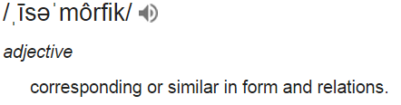
Isomorphic

Slide 15

What’s In a Name?
Okay, we’re both doing Isomorphic JavaScript. But you may hear these other terms.
Universal JavaScript
Shared JavaScript
FastBoot (EmberJS)
Portable JavaScript
Progressive JavaScript
Client-Server JavaScript
Multiplatform JavaScript
End-to-end JavaScript
Server-rendered SPA
Samesies.js
Fronty-backy JS
JS on server & client
Notes:
There’s plenty of opinions on the term isomorphic JavaScript. The term was coined by the AirBNB team back in ???
Samesies.js
Fronty-backy JS
Shared JS code rendered on the client and the server

Slide 16
Why Go Isomorphic?

Slide 17
Server
Client
HAML
Razor
Django
Jade
Handlebars
Knockout
Angular
KendoUI
Duplication
Notes:
I’m sure you already understand what templates are. They’re a way to define a preset format for reuse. And all sorts of server-side technologies offer a template-like solution. HAML is a popular templating solution used by Ruby and PHP developers. If you’re in ASP.NET MVC, then the Razor view engine is a popular templating option. Python developers are likely familiar with Django, and Node developers often use Jade. The point is, there’s a huge number of server-side solutions for templating. But what if you decide to render the UI on the client instead?
These days it’s common to render the UI on the client. Handlebars is a lightweight library for doing so. Knockout and Angular offer their own templating systems, and Kendo UI has their own as well. The problem is, if you’re using these technologies, you can’t easily share code between the client and the server. The technologies on the left are for the server. And the technologies on the right are for the client. So if you want to render the app initially on the server, and then do rich client-side interactions after the initial load, you’re stuck maintaining two separate technology stacks and trying to keep them in sync manually.

Slide 18


What Is Duplicated?
Templates
Security
Routing
Models and validation
Configuration
API calls
Date & Currency Formatting
Notes:
Imagine we decided to server and client-side render our application using two different technologies. We could select a popular server-side technology like ASP.NET MVC, Ruby on Rails, or Python. And on the client, we might choose to build the app using Angular or Ember.
But the problem with this approach is we end up repeating ourselves. We’d end up having to write and maintain code in two or more separate languages. And we’d have to try keeping these technologies in sync manually. Just think about all the duplication:
Templates – For instance, we’d have to keep server-side Razor or HAML templates in sync with client-side templates like handlebars or Knockout templates.
Security – If we have security concerns that determine whether someone can see a button, then we’d have to define these rules in both C# and JavaScript.
Routing- What content should be displayed for a given URL? With a separate client and server approach you’d have to define your routing rules on both sides. So, for example, you’d end up defining routes for ASP.NET MVC or Ruby on Rails on the server, and also for Angular or Ember on the client.
Models and validation – Since you’d need the model data on both the server and the client, you’d have to devise a way to make the model available on both sides. This issue is admittedly easier to solve than others since you could simply serialize a server-side type into JSON for use on the client. For example, you could serialize the viewmodel that you use in ASP.NET MVC into JSON for use on the client. However, any validation rules would need to be repeated on both the server and client again.
API Calls – Any wiring for API calls would be repeated on both the client and server.
Formatting – Imagine you need to format data like dates, currency, or internationalization issues. You’d again have to create duplicate code on the client and server to handle these rules. Just consider handling dates and times. Perhaps you’d use ASP.NET DateTime libraries on the server and something like moment.js on the server. Any code you write on one side would look vastly different from the other due to the need to utilize different languages and frameworks on the client and server.
And of course, this list of duplication isn’t comprehensive. The point is, if you create separate server and client-side solutions, you’re in for writing a long list of similar code in separate technologies. And you’re going to have to keep both sides in sync by hand. That’s error prone and time-consuming.

Slide 19
Client vs Server
Server
Client
Less demanding of the client
Faster initial render
SEO optimized
Fast interactions
Rich transitions
Uses less bandwidth
Avoids full page loads

Slide 20



Why Go Isomorphic?
Performance
Accessibility
Maintainability
Notes:
So why go isomorphic? There’s no denying it adds another layer of complexity. But once we can run JavaScript everywhere, we gain some clear benefits over old patterns like progressive enhancement.
There are three clear benefits with rendering the same code on both the client and the server including:
Performance
Accessibility (Progressive enhancement)
Maintainability (DRY)
Let’s consider each of these benefits in more detail.

Slide 21

Why Go Isomorphic?
Faster initial load* (Coursera: 4x sooner)
No waiting for JS to download and parse
Immediately readable
No flash of unstyled content
Performance
Notes:
Coursera found that its worldwide audience has slow connections. They found isomorphic gave them something to read 4x sooner. And for the 10% with even slower connections, the gains were even greater. https://medium.com/building-coursera/why-and-how-coursera-does-isomorphic-javascript-a-fast-and-snappy-quiz-5ba7bb9bf367?imm_mid=0d7e38&cmp=em-web-na-na-newsltr_20150902
Sure, client-side rendering provides rich, fast interactions in the browser. But rendering HTML on the server often improves initial page load performance. Client-side rendering often requires longer for the initial page render. Why? Well, just think about what happens when a JavaScript heavy application is initially loaded…
Interesting: 1,000 row table in ReactJS shows isomorphic is actually slower Why? 2x page size from redundant table html.

Slide 22
Why Go Isomorphic?
SEO
Disabled JavaScript
Screen readers
Progressive enhancement
Accessibility
Notes:
The second big reason to render on the server is accessibility.
If you’re building a web application that’s concerned about search engine optimization, rendering on the server can assure that search engines properly index your content. Search engines like Google admittedly now parse JavaScript, but it has been very vague about what this means for rich JavaScript based applications. It’s still unclear exactly how much we can rely upon Google’s crawler to parse complex JavaScript applications. Regardless, other search engines currently do not parse JavaScript, which means any content that requires JavaScript to render is invisible to search engine indexing. In such cases rendering on the server can greatly increase your application’s visibility to search engines.
Although it’s admittedly quite rare these days, if someone disables JavaScript, a client-side rendered app will either be very broken or often display no content at all. Since an isomorphic app is initially rendered on the server, it sends down plain old HTML to the browser. This means users can see content even with JavaScript disabled.
Finally, screen readers struggle with complex client-side rendered applications. Rendering on the server can assure that simple, semantic HTML markup is sent to the client. Clean semantic markup is much more likely to be accessible by people with a wide array of browsers and abilities.

Slide 23
Why Go Isomorphic?
Don’t repeat yourself
Reduced context switching
Maintainability
Notes:
The third reason to go isomorphic is for maintainability. We no longer have to write everything twice to get the benefits of both client and server side rendering at the same time! In other words, our code stays DRY. The DRY principle is a commonly discussed best practice in software development. Isomorphic JavaScript means we can avoid creating separate server and client-side templates, routing, formatting, etc. The same code can be utilized on both the client and the server. Using the same language, tooling, and technologies on both the client and server also aids maintainability because you no longer have to context switch. You can choose one IDE that you find works best for JavaScript instead of working in two radically different systems.

Slide 24
Demos
Notes:
One of the hardest parts of creating a React application is making a decision on all the related libraries to build a full application. Remember, React is merely the view layer. So it doesn’t have any opinions on how to handle data flows or routing.
In this course, we’ll use Facebook’s Flux because it’s popular, proven, and supported by Facebook. I’m not saying it’s the “best” flux implementation. In fact, I recommend investigating the alternatives. The good news is, once you’re comfortable with Facebook’s Flux pattern, you can easily pick up the alternatives and better appreciate their differences.
There’s also a huge number of routing options, but we’ll use the most popular option: react-router. This router is also supported and used by Facebook. It has excellent documentation.
Finally, you can choose whatever IDE you like. As you’ll see, most popular IDEs either have native JSX support now or have plugins to add JSX support. In this course, we’ll use SublimeText, but you can follow along in Brackets, Atom, or the IDE of your choice.
-------------
Isomorphic: Fluxible, react-engine
If you choose to go isomorphic, there’s a number of engines to choose from. React-router has isomorphic support, and using is combined with react-engine is a simple path that Paypal uses.

Slide 25



Core Tech
Server-side JavaScript
Node packages in the browser
Components
Task runner
Notes:
Let’s walk through the core technologies we’ll use to build our app.
When building an app with React, you need to choose a language that runs on both the server and the browser. And today, that means JavaScript. And the most popular way to write JavaScript on the server today is via NodeJS.
Node comes with package manager called npm which we’ll use to install the packages we need.
Node packages that you find via npm aren’t packaged for use in the browser, so we’ll use Browserify to bundle the node modules we use into a single file that will run in the browser.
React is a popular component library created by Facebook. In this course will use React to compose our application out of many small React components.
Flux is also from Facebook and commonly used with React. Flux is more a pattern than a library, but we’ll use Facebook’s implementation of Flux to handle data flows in our application. As you’ll see, Flux implements a unidirectional data flow which helps assure that even large, complex apps are easy to understand.
Finally, we’ll use Gulp as the task runner that wires all of this together in an easy to use script. Gulp will start up our webserver, bundle up our files, and reload the app when we change code.
So this the technology stack that we’ll explore throughout this course. Let’s discuss each of these technologies in a bit more detail.

Slide 26
React.renderToString

Slide 27










Other Isomorphic Options
isomorphic.net
Notes:
There’s a long list of alternative isomorphic libraries and frameworks out there including… And the wild thing is, this is just a selected list of 10. There are quite a few more. This course uses React because it’s battle-tested in production on one of the highest traffic’d websites in the world: Facebook. React is
If you’d like to see the full current list, check out isomorphic.net.

Slide 28













Battle Proven
Notes:
Note that these are all public facing sites. That really matters. You have to ask yourself, what is my motivation?

Slide 29
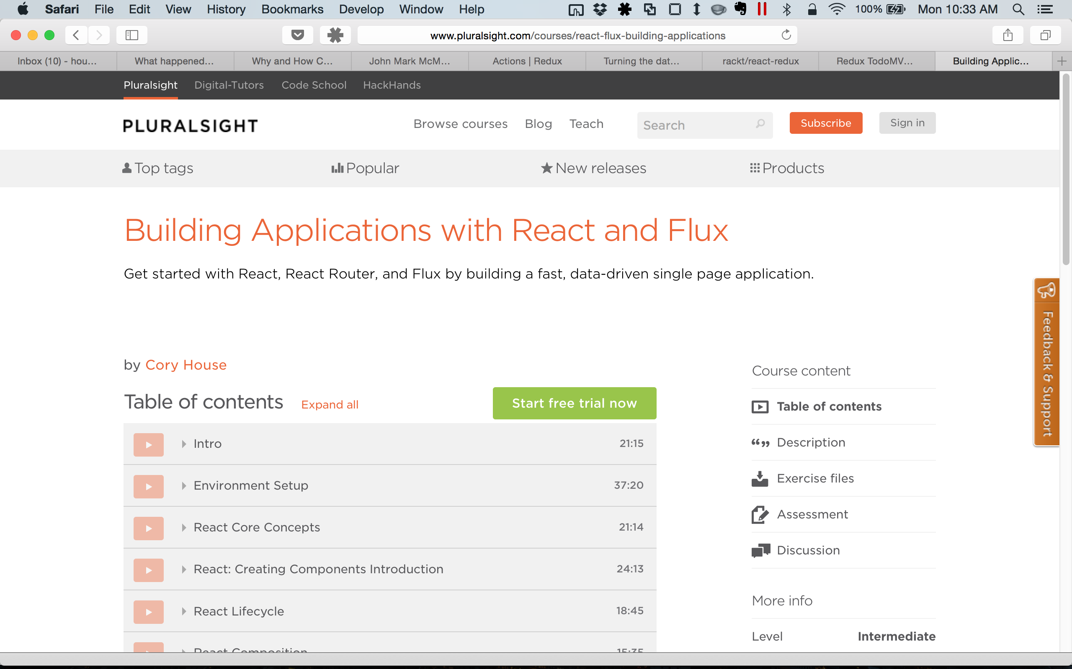
Notes:
Add screenshot of PS course

Slide 30
Two Approaches
1. Node Server-side Rendering
2. React Rendering Service
Node renders React components
Work in JS everywhere
Reuse all code on client & server
Service returns rendered HTML
Keep your current server-side tech
Add React incrementally
Notes:
When creating an isomorphic web application, there’s two fundamental technical approaches you can consider.
The first, and most obvious option is to choose an isomorphic stack. Today, that typically means using Node on the server to parse and render your HTML. Why Node? Because our components are written in JavaScript, we need a server-side solution that works with JavaScript. So Node is an obvious choice for the server-side solution. And since React was designed from the ground up to support isomorphic rendering, it’s as simple as calling React.RenderToString to your top level component so that Node with Express can send down the resulting HTML.
This approach offers the simplicity of working in a single language on both the client and the server. This can make it easier to find and hire capable developers. It also avoids the context switch of working in different languages and technologies on the client and the server.
And since you’re working only in JavaScript on both the client and the server, you can easily reuse code on both the client and the server. Now given, as you’ll see, it’s important to select abstraction layers for concepts that differ on the client and server like getting and setting cookies, and making http calls to services. However, there are existing libraries available on npm that provide abstractions over the differences between the client and the server.
The second option is to create a webservice that renders your React component and returns the final HTML. This approach lets you continue working in whatever server-side technology you’re currently using. ASP.NET, Ruby, Python, PHP, whatever. It doesn’t really matter. As long as your server-side language can make an HTTP call, you can utilize server-rendered React components.
Now the exact technical approach on the server will of course depend on the server-side technology you’re using. But as you’ll see in the example, this approach is conceptually quite simple. Facebook still uses PHP behind the scenes in a variety of places, so they can simply call file_get_contents within a service that runs Node and Express. This service simply returns the result of React.RenderToString and the requested component! ☺
The benefits of this approach is you can slowly move toward React, without losing the benefits of server-side rendering. However, compared to the pure Node approach on the left, this approach does add the overhead of an HTTP request on server to get rendered HTML from Node.
Regardless of which approach you choose here, the React component is initially rendered on the server. You get all the benefits of an isomorphic application. So there’s no effect on your search engine optimization, and your pages render just as fast as before since the browser continues to be sent the final HTML with either approach.

Slide 31
React Rendering Web Service
Website
(Ruby, .NET, Python, whatever)
HTTP Request
Node Web Service
React.RenderToString
React Component
HTML
myApi.com?component=App &props=%7B%22name%22%3A%22Cory%22%7D
Notes:
Before we build an example of the React Rendering Web Service, let’s walk through the approach. It’s really a simple three step process:
Create web service that returns results of React.RenderToString
Call web service on server
Inject HTML and React bootstrapping code onto page
In more detail:
The first step is to create a webservice that uses Node and Express. Remember, we’re using Node and Express because we need a server-side environment that works with JavaScript. This service would typically take two parameters: The name of the component you want to render, and some JSON declaring the properties you’d like to set on the component. This service calls React.RenderToString to get the resulting HTML for the component, and any child components. So typically you’d request a high level component that composes many child components underneath. Facebook commonly calls such components controller views. But really, that’s just a fancy word for a component that marshals data and passes it on to multiple child components.
The second step is to call this webservice on the server from your current server-side language. If you’re using this approach, it really doesn’t matter what server-side technology you’re using. PHP, ASP.NET, Ruby, Python, whatever, The point is, on this step we write some code that calls the Node web service that we created in step 1. Of course, the exact code you write will depend on your server-side language, but we’ll look at an example using .NET in a moment.
The final step is to take the HTML returned from the webservice and inject it onto the page, along with the appropriate React bootstrapping code.
Specific example:
Send //http://localhost:3000/?module=./components/App&props=%7B%22firstName%22:%22Cory%22,%22lastName%22:%22House%22%7D
Note that querystring is created by doing this: encodeURIComponent(JSON.stringify({firstName: 'Cory', lastName: 'House'}))
NOTE: This style is inspired by: https://github.com/facebook/react/tree/master/examples/server-rendering
Also note that isomorphic React performance is currently slow since it’s blocking the Node event loop https://github.com/facebook/react/issues/3009#issuecomment-132001925

Slide 32
React Rendering Web Service
DEMO
Notes:
Alright, let’s create a simple ASP.NET application that utilizes a simple web service to render React components on the server.
Webservice example: C:\Users\housecor\Dropbox\Courses\Isomorphic React\Demos\react-starter-kit\examples\server-rendering\reactserver
.NET Example: C:\Users\housecor\Dropbox\Courses\Isomorphic React\Demos\cory-dotnet-calling-react-service\DotNetConsumingReactService
Steps to setup this Demo:
Fire up Parallels
Open Git Bash
cd /y/Courses/Isomorphic\ React/Demos/demo/demo1-react-service/node-react-service
npm run start
Open homeController and Index.cshtml in Visual Studio MVC project
Open node-react-service folder in Sublime
Open the browser to localhost:3000
Hit the webservice http://localhost:3000/?module=./components/App&props=%7B%22firstName%22:%22Cory%22,%22lastName%22:%22House%22%7D

Slide 33
github.com/coryhouse

Slide 34
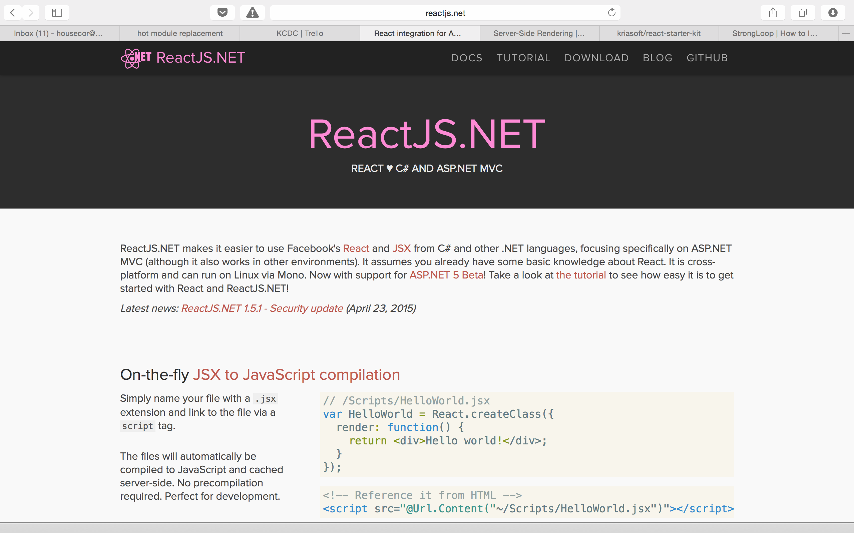
Notes:
ReactJS.NET is a project that makes it easy to use React with .NET. You just download their package and it does this stuff for you:
Installs React
Add a build step that compiles your JSX
So to get started, you simply:
Install the ReactJS.NET Nuget package
Add a reference to React in your view.
Add references to any JSX files you’ve created to your view.
Some quirks:
You don’t actually include react at the top of your component files. Seems to do that for ya
You can’t put any code in there that assumes you’ll be in a browser (e.g. alert) since that jacks up isomorphic support (though I haven’t tested if it works without isomorphic support on)
Can’t declare a module.exports at the bottom of the file. Seems to only like using plain JS file.
Don’t see how to reference files using this tech. Referencing via common js export style doesn’t work.
Have to build your whole .NET app to trigger the React JSX compilation.
Seems to sometimes hold on to old React JSX files even after rebuild.

Slide 35
ReactJS.NET
DEMO
Notes:
Non-Isomorphic: http://reactjsdotnet.azurewebsites.net/
Isomorphic: http://reactjsdotnetisomorphic.azurewebsites.net/
Used tutorial. Note that I had to add this binding redirect to web.config under <configuration> to fix Newtonsoft.JSON:
See this SO thread: http://stackoverflow.com/questions/22507189/could-not-load-file-or-assembly-newtonsoft-json-version-4-5-0-0-culture-neutr
<runtime>
<assemblyBinding xmlns="urn:schemas-microsoft-com:asm.v1">
<dependentAssembly>
<assemblyIdentity name="Newtonsoft.Json"
publicKeyToken="30AD4FE6B2A6AEED" culture="neutral"/>
<bindingRedirect oldVersion="0.0.0.0-6.0.0.0" newVersion="6.0.0.0"/>
</dependentAssembly>
</assemblyBinding>
</runtime>

Slide 36
Some Final Thoughts…

Slide 37
What Did Isomorphic Cost Us?
Isomorphic Tech
Complexity
Extra Abstractions
Notes:
We had to choose an isomorphic friendly tech stack. We had to carefully select libraries that run on both the client and the server for components, routing, templating, module loading.
We had to utilize extra abstractions over the browser and node server environment so that our code would run on both sides.

Slide 38
Interactions Before Full Load 3 Options
Warn
Limit Interactions
Web 1.0
Notes:
More context here: https://medium.com/building-coursera/why-and-how-coursera-does-isomorphic-javascript-a-fast-and-snappy-quiz-5ba7bb9bf367?imm_mid=0d7e38&cmp=em-web-na-na-newsltr_20150902

Slide 39
Isomorphic will be easy. But it’s not, yet.

Slide 40
Server
Client
React
React Router
Isomorphic Flux
Superagent
Moment
Cookie
Node with Express
Browserify/Webpack
Notes:
Let’s consider where we are so far.
In modules 1 and 2, we walked through using Browserify so that we could use Node modules in the browser.
And In this module we’re going to use node and npm combined with express to render the application on the server.
But this final module is about bringing the client and server worlds together and using the same technologies and code to render both sides. That’s why we strategically selected a number of technologies that work well on both the client and the server.
We use React as our component library since React components can easily be rendered on both the client and the server.
And in module 2 we used React-router to load the proper components based on the URL requested. We selected this router because it will work on both the client and the server as well.
For the AJAX calls that we wired up in module 3, we used superagent instead of popular alternatives like jQuery. Why? Again, because superagent provides a simple abstraction that works on both the client and the server.
When formatting dates, we used moment.js, a JavaScript date library that we pulled in via npm.
And for cookies, we used cookie from npm. Since the api for setting cookies via the server is different than the client, this library provides an abstraction that works in both places.

Slide 41
The Isomorphic Spectrum
Potentially Isomorphic
Templates
Routing
Model validation
Configuration (see Configuration section)
API calls
App Logic
Date & Currency Formatting
Notes:
As you start doing more of the above, you introduce more abstractions to handle the API differences between client and server. (or better yet, use npm packages). All of these aspects can be potentially isomorphic. And you don’t have to do all these at once. You can start by selecting one or two of these to handle isomorphically.

Slide 42
Who’s Going Isomorphic?
Notes:
Add coursera

Slide 43
Isomorphic = true;
Notes:
In the future, I believe every JavaScript framework is going to need an isomorphic option that is this simple to compete. You’ll simply Add a futuristic picture here.
Isomorphic is the future.

Slide 44



speakerrate.com
@housecor
pluralsight.com
Notes:
And you can find my courses out on Pluralsight.
This session you just saw is a course that’s about half written. Was this helpful? Please rate it on speakerrate
Thanks for listening!

Slide 45
Node
Server-side JS
Uses the V8 Engine
Includes npm package manager
Notes:
Building an app with React and Flux doesn’t require using Node, but Node helps make our job easier. Node runs JavaScript on the server using Google’s fast V8 engine. Node now includes npm, which is Node’s package manager. Npm includes 1000’s of useful JavaScript libraries. So we’ll use npm to pull down the libraries we need for our project. If you haven’t used Node, don’t worry, we’ll walk through the basics of what you need to know to get going in this course. But if you want to learn more, there are a number of courses on Node here on Pluralsight.

Slide 46







npm: Node’s Package Manager
.NET
Ruby
Java
Python
PHP
The Web
Node
Notes:
As I said on the previous slide, Node comes bundled with its own package manager called npm. Npm is how we’ll install and manage the dependences we need to run our app. You’re likely already familiar with the concept of a package manager if you code in a server-side language.
.NET developers use Nuget
Ruby has Rubygems
Java has Maven
Python has PIP
PHP has Pear
And front-end developers often use Bower to manage packages related to HTML, JavaScript, CSS, and other things web related.
Npm is Node’s package manager. It provides a quick, easy way to install node packages. One you’ve installed Node, you simply type npm and the name of the package you’d like to install.

Slide 47

React
Component Library
Simple composition
Utilizes virtual DOM
Can render on client and server
Notes:
For our component library, we’re going to use React. React is a project from Facebook that handles a very specific set of concerns: packaging, composing, and rendering HTML components.
Because of this focus, React is lightweight and makes it easy to create complex Uis by composing many simple components together. Because React is so focused on this one goal, it can even be used along with other frameworks like Angular and Backbone.
React utilizes a virtual DOM, which makes it very fast. When the UI changes, React compares the old state to the new state in memory and then updates the DOM in the least expensive way. This saves resources and makes React notably faster than many of today’s popular alternatives.
And with the power of the virtual DOM, React can even support rendering on both the client and the server. This of course is critical for building isomorphic apps, and really sets React apart from other traditional libraries and frameworks that are currently very DOM oriented like Angular and Knockout.

Slide 48
Browserify
Use Node modules in the browser
Bundle dependencies
Notes:
There are a variety of patterns and tools for managing and bundling dependencies in JavaScript. RequireJS is a popular choice, but Browserify has become increasingly popular because it bundles up Node modules so that you can use them in the browser. And that’s really handy because npm has 1000’s of useful JavaScript libraries. So it’s great by simply using Browserify all of npm’s packages can now be easily used in the browser. By default, Browserify bundles all your dependencies into a single file.
Note, Webpack is a popular alternative. For info on choosing between the two: https://github.com/kriasoft/react-starter-kit/issues/3
Steps to setup demo: (likely move this to a separate slide)
npm install –g browserify
Create directory to house the test project
Install a 3rd party dependency like lodash: npm install –save-dev lodash
Create a js file that requires lodash, then reference that file in index.html
Run browserify scripts/main.js > bundle.js. Browserify will bundle the node modules and your code into a single js file that the browser can consume.
Note how I can use –d to generate with sourcemaps to support debugging. Then can set breakpoints in the files. But also note how 333k of JS became 950k, so only want to do in dev.
But what if we want browserify to re-run anytime we save a file? Then use watchify instead. It takes the same params as browserify, but watches your files too. So:
Npm install –save-dev watchify
But what if I want to run it as part of on ongoing build process via Gulp or Grunt? Well, let’s set that up using Gulp.
First, install Gulp: npm install –g gulp
So how does Browserify work? It simply looks through each of the files that match the glob that you specify. For every require() call with a string in it, browserify resolves those module strings to file paths and then searches those file paths for require() calls recursively until the entire dependency graph is visited. Each file is concatenated into a single javascript file with a minimal require() definition that maps the statically-resolved names to internal IDs.
This means that the bundle you generate is completely self-contained and has everything your application needs to work.
Now note, Browserify isn’t the only module loader option out there. There’s also currently RequireJS, WebPack, SystemJS, and JSPM. But the reason I’m choosing Browserify is because it has a very focused mission: Make npm modules work in the browser. This is exactly what we need for an isomorphic app, because we need to assure that the module loader and packages we choose run on both the client and the server. If we were doing only traditional client-side rendering, then RequireJS is a popular choice.

Slide 49
Gulp
Task runner
Rich plugin ecosystem
Stream-based
Notes:
To tie all this together, we’ll use Gulp. Gulp is a popular JavaScript based task runner. Grunt is a popular competitor that would work just fine for our purposes as well, though Gulp has recently gained a great deal of popularity because it’s easy to configure and very fast.
Gulp has a rich plugin ecosystem that allows us to easily automate all sorts of important tasks like minification, linting, bundling, moving files, running tests, and watching files so your browser automatically reloads when you save file changes.
Gulp is fast because it’s stream based. Gulp allows you to glue a number of tasks together by taking the output from one plugin and uses that output as input for the next plugin. Keeping all the work in memory rather than writing to disk is what makes Gulp so much faster than its current primary competitor, Grunt.
Gulp can perform 100’s of different tasks. Our primary use when building our example app is to watch files and run the Watchify plugin. This plugin will automatically bundle our code using Browserify as changes are made to the solution.
Again, to clarify, you don’t have to use Gulp, Browerserify, or Node to build applications with React and Flux. But as you’ll see, these tools help streamline the process.

Slide 50
A World of Components
Notes:
These days there is a huge list of different ways to create web Components.
You can buy off the shelf components from Telerik like KendoUI.
You can use open source components like jQueryUI.
Knockout offers components.
Ember offers components.
Angular offers components that it calls directives.
And there are even native web components that follow a new standard. If you’re interested in learning standards-based web components, you can check out my course on HTML5 Web Component Fundamentals here on Pluralsight.
Now, given some of these are pure component libraries, while others listed here are full fledged application frameworks. Yet each does offer a unique way of handling components.
The bottom line is we have a vast list of options for creating component-based UIs for the web today. And React is yet another option. So what makes React special? Why should you choose it over all these other options? Well given today’s landscape, there are some great reasons. Let’s consider what unique qualities React has to offer:

Slide 51
They call it React for a reason.
Notes:
Gif of people with torches.

Slide 52
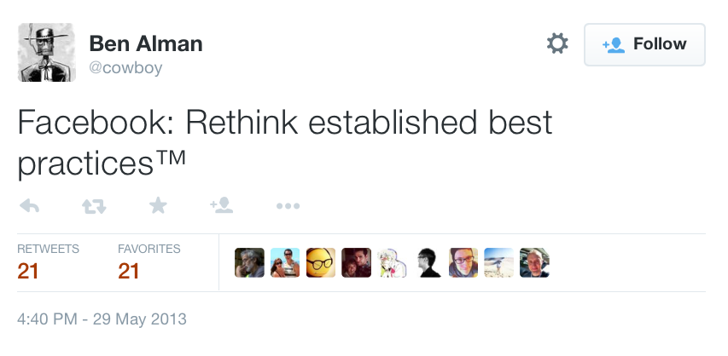
Notes:
Add https://twitter.com/cowboy/status/339858717451362304
React takes all sorts of existing best practices, and deliberately ignores them. So if you’ve never seen React and Flux, I’m going to have to ask you to keep an open mind. To try to limit your initial urge to vomit in your mouth or rage quit and run out the door.
Because trust me, all best practices should be questioned from time to time. Our industry moves so fast it would be silly for us to blindly continue to blindly follow the same paths. If you’re willing to listen with an open mind today, I hope I can sell you on rethinking the way you’re doing front end development.

Slide 53
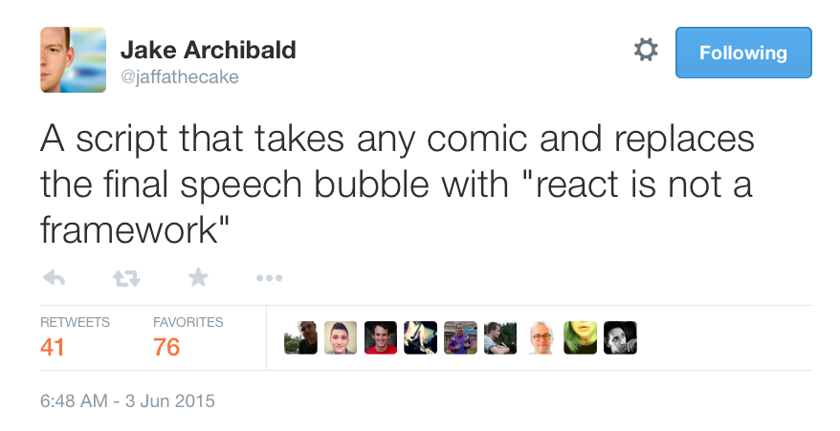
Notes:
React is not a framework meme here
Angular is so tired of the comparisons that they’re starting meme’s like this.
https://twitter.com/jaffathecake/status/606064895805792256

Slide 54
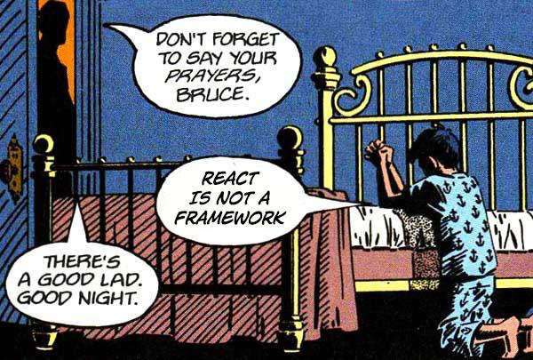

Slide 55
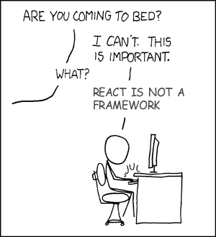

Slide 56
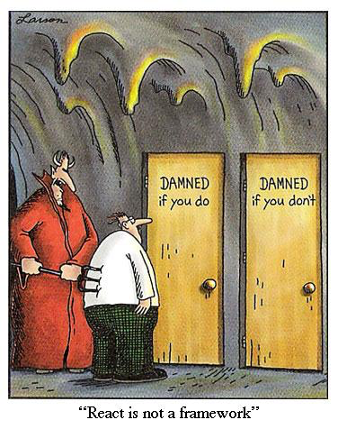

Slide 57

Notes:
So welcome to church. Yes, talking religion makes some people uncomfortable. But I want to be clear. In the next hour I’m going to be unapologetic about my enthusiasm for React, Flux, and related technologies. This isn’t some balanced pros and cons list. This is a sales pitch from someone who is in love. My goal is simple. I want to convert you. And to do that, I’m going to show you a lot of cool things. But let me be clear, this session is for you. So if you see holes in my points, challenge me. I believe React with Flux is the most attractive way to build responsive web applications today. And as you’ll see soon, I’m not alone.

Slide 58

Innovation
JSX
Virtual DOM
Hot Reloading
Isomorphic Rendering
Unidirectional Flows
Notes:
In this talk I want to explore 5 innovations in React and Flux. And to clarify, I’m not claiming that React and Flux are the first libraries to utilize all these patterns and technologies, but React and Flux are the first libraries to rich critical mass and help bring these approaches to the forefront.

Slide 59
Innovation creates polarizing views…

Slide 60
JavaScript and HTML belong in the same file.
Notes:
For years we’ve talked about separation of concerns as a common best practice. But is separation of concerns always a good thing? What if they’re completely intertwined and there’s no strongly typed explicit interface to keep them in sync?

Slide 61
Unidirectional flow > two-way binding.
Notes:
For years we’ve talked about separation of concerns as a common best practice. But is separation of concerns always a good thing? What if they’re completely intertwined and there’s no strongly typed explicit interface to keep them in sync?

Slide 62
All Variables Should be Global.
Notes:
And now, we’ve entered a new era: Global variables are awesome! Okay, I’m kidding. That was totally a test. Yes, React has some controversial ideas, but this is one step too far. The other stuff I mentioned is legit though, and we’ll explore why in this session.

Slide 63

Notes:
JSX is like an ugly baby. At first you’re going to have to hold back a cringe. But after you give it some time, you’re going to fall in love. Trust me. And with that, allow me to show you my ugly baby.

Slide 64
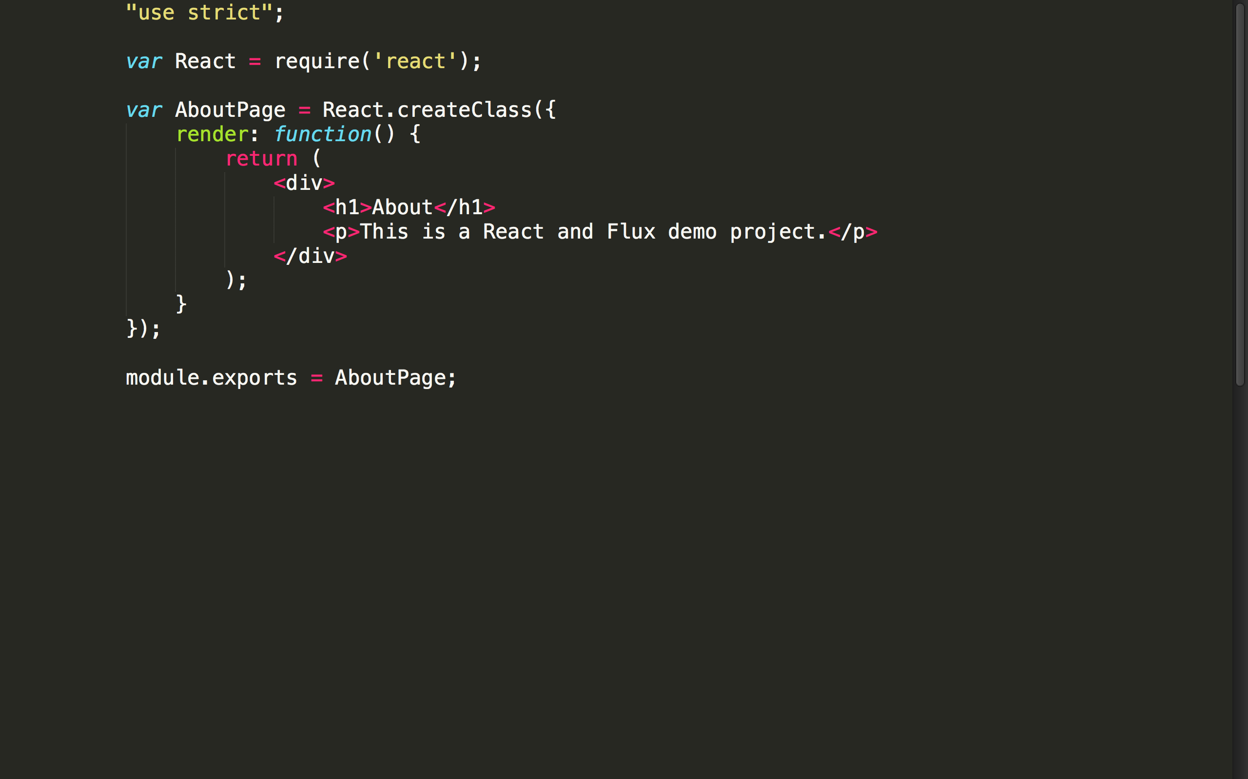

Slide 65


Slide 66
JSX
“HTML” in JavaScript
Compiles to JavaScript
Differences: className, htmlFor
Optional
Notes:
React uses an optional XML-like syntax called JSX for markup. It looks almost identical to HTML. That’s why I put quotes around HTML. It’s not actually HTML, but has a nearly identical in syntax.
There are some minor differences such as using the className instead of class and htmlFor instead of for.
Of course, a browser wouldn’t know what to do with JSX, so JSX compiles down to plain JavaScript. So really, JSX is an abstraction over plain old JavaScript calls.
Thus, JSX is totally optional. You can use JavaScript to declare your markup if you prefer, but it’s recommended to use JSX because it’s much easier to read, more approachable for designers, and more concise.

Slide 67
JSX Compiles to JS
<h1 color="red">Heading here</h1>
React.createElement("h1", {color: "red"}, "Heading here")
Notes:
Here’s a quick example of JSX. As you can see, the JSX on the top looks like HTML. As I mentioned on the previous slide, there are only a few minor differences like using className instead of class and htmlFor instead of for.
And this JSX compiles down to plain old JavaScript. As you can see it becomes a call to React.createElement. The function is passed the name of the tag you created, an object that specifies the attributes you’d like to set, and finally, the markup that should sit inside. This final parameter will contain calls to other elements if you have nested markup.
So yes, you can avoid JSX if you want to do it the hard way and write this JavaScript yourself. But it’s harder to read, takes more time to type, and is much less friendly to designers, so I recommend using JSX.
XML has the benefit of balanced opening and closing tags. This helps make large trees easier to read than function calls or object literals.

Slide 68
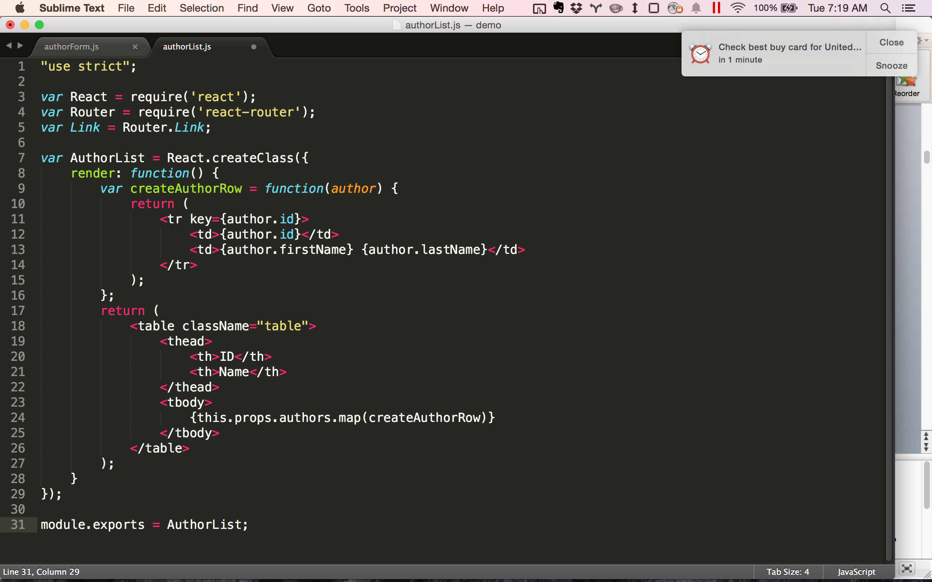
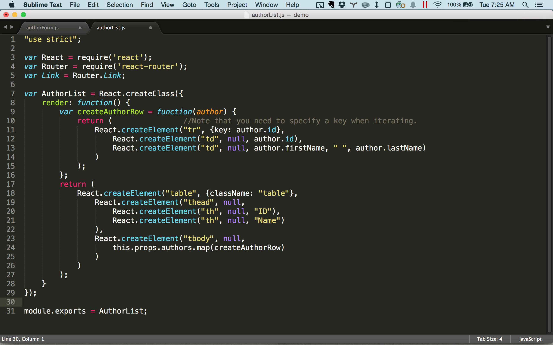
Notes:
Note that the brace matching nature of JSX makes it much easier to read and understand than the raw JavaScript. It’s less clear to spot a missing closing tag with raw JavaScript since it’s simply a parenthesis.

Slide 69
“JS” in HTML
<div ng-repeat="user in users">
{{#each user in users}}
data-bind="foreach: users">
“HTML” in JS
{users.map(createUserRow)}
Notes:
Ember uses handlebars style to put “JS” in HTML: http://guides.emberjs.com/v1.11.0/templates/displaying-a-list-of-items/
Instead of putting JS in your html, put html in your JS. Instead of patching your html with ng-ifs and ng-repeats you map your props in a little component.

Slide 70
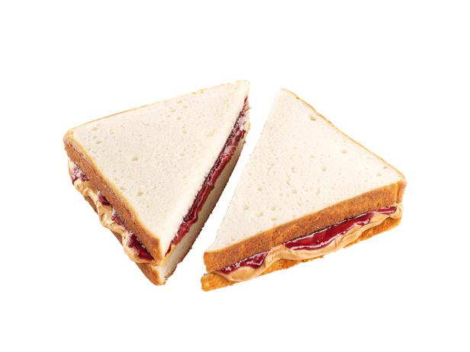
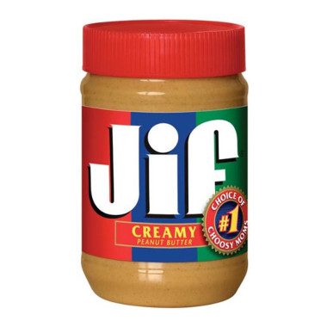
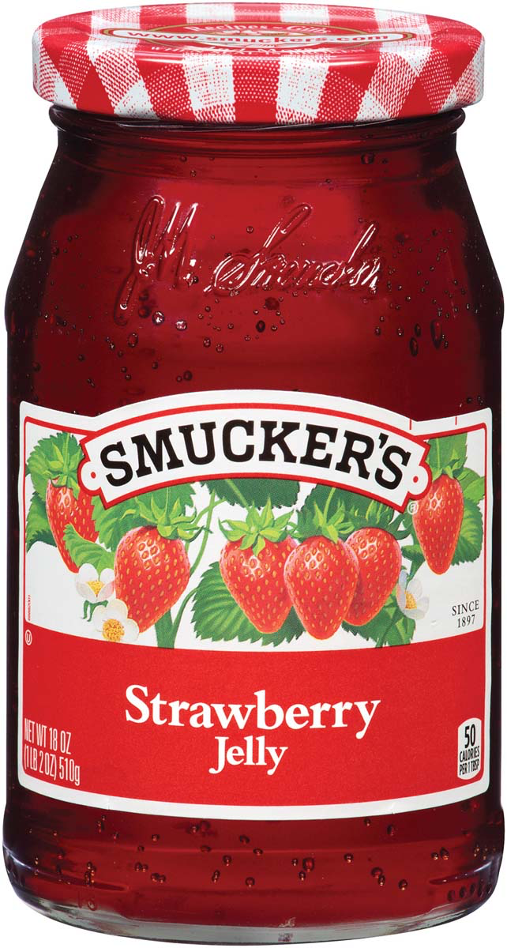
Notes:
By the way, you pronounce the one on the right “gif”.

Slide 71


Must stay in sync.
No explicit interface!
Notes:
In most server-side languages, we have the luxury of using strongly typed interfaces
Insert pic of conjoined twins here.

